Slide 1
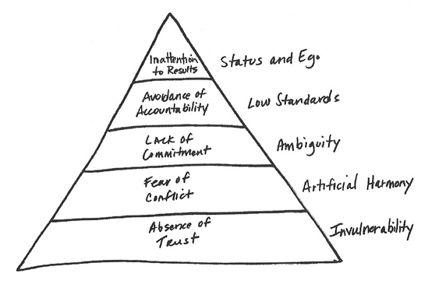
Pyramid from The 5 Dysfunctions of a Team (Lencioni)

Slide 2
Leadership-related terms and questions
Relationships
Possibility
Vision
Action
Mobilize
Integrity
Community
Positive change
Inspire
Coach
Dream
Mentor
Communicate
Trust
Respect
What is the difference between an effective leader and a good leader?
What is the place of integrity in leadership?
How would you judge leaders who inspired atrocities (e.g., Hitler, Stalin, Kim-Jong Il)? Would you deem them ineffective leaders? Bad leaders?

Slide 3
A few definitions of leadership
“Leadership involves living in a state of possibility, making a commitment to a vision, developing relationships to move the vision into action, and sustaining a high level of integrity. Effective leadership takes place in the context of a community and results in positive change.” (LeaderShape® Institute)
“If your actions inspire others to dream more, learn more, do more and become more, you are a leader.” (John Quincy Adams)
“Leadership is a function of knowing yourself, having a vision that is well communicated, building trust among colleagues, and taking effective action to realize your own leadership potential.” (Warren Bennis)
“To lead people, walk beside them ... As for the best leaders, the people do not notice their existence. The next best, the people honor and praise. The next, the people fear; and the next, the people hate ... When the best leader's work is done the people say, “We did it ourselves!’” (Lao Tsu)
Note: Leadership goes beyond the power to influence. They’re about having a vision, inspiring others, and doing so with integrity, respect, and trust.

Slide 4
